Slide 1
ParkHere
April 15, 2017

Slide 2



MEMBERS

Slide 3
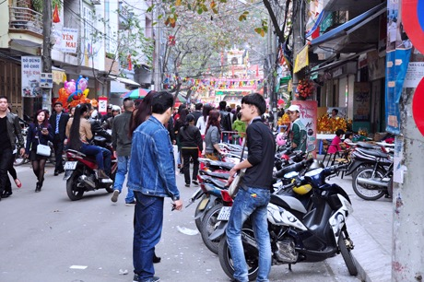
OUR IDEA
You don’t know where you can park your bike?

Slide 4
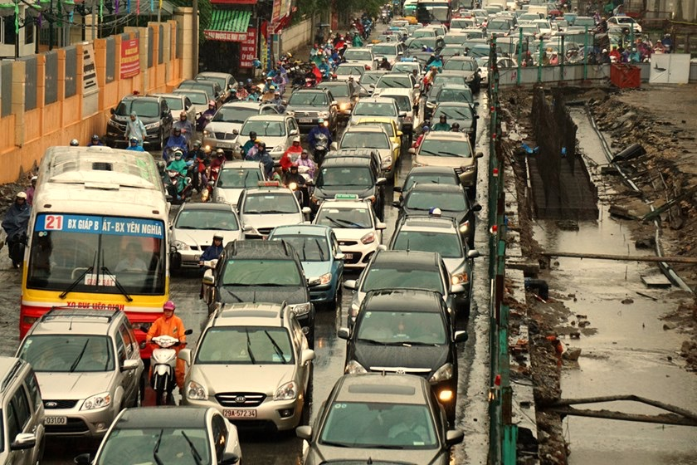
OUR IDEA
You want to escape this jam ASAP?

Slide 5
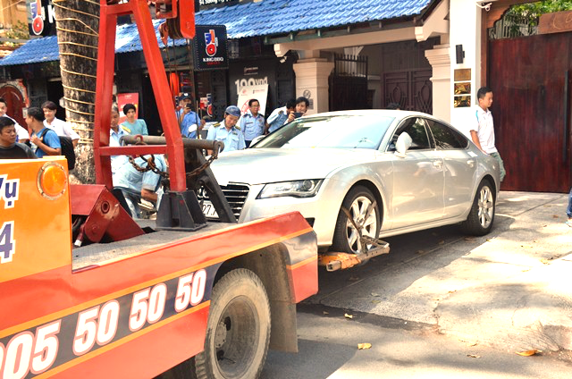
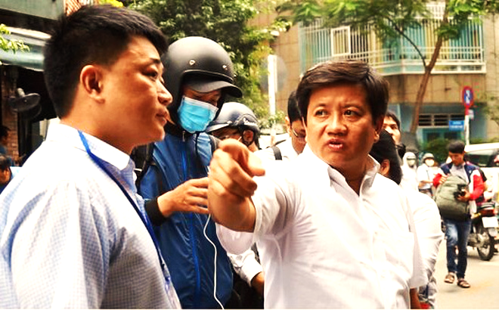
OUR IDEA
Sidewalk Clean Up campaign

Slide 6

CURRENT SOLUTIONS

Slide 7
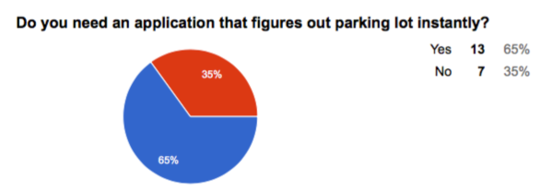
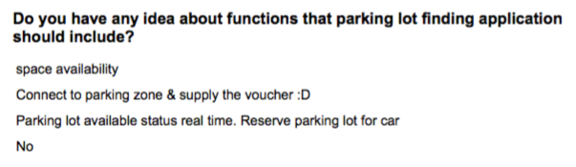
DO THE SURVEY

Slide 8

OUR SOLUTION
An iOS app helps you to find the most suitable
parking zones around you.

Slide 9

OUR SOLUTION (.cont)
Google Oauth Service
ParkHere Admin Module
ParkHere

Slide 10
DEMO
Tan is on the way to see his boyfriend, and he wants to find one parking zone around this area, and he is using ParkHere app…

Slide 11
WHAT’S NEXT?
Improving app with UI as well as optional features.
Enriching the parking zone database, and the contribution from users is really important, and we want to have fund to support for user’s contribution, for i.e:
PARK FOR FREE

Slide 12
ParkHere
April 15, 2017

